Slide 1
Connecting devices
Repeater,Hub,Bridge,Switch,Router ,Gateway
Prepared by
Divya K S
Adi Shankara Institute of Engineering & Technology
Kalady

Slide 2
Bridge
Used to connect multiple LANs (working on the same protocol) together to form a larger LAN.
Bridges operate at the data link layer of the OSI model and hence also referred as Layer 2 switches.(can operates in both the physical and the data link layer.)
As a physical layer device, it regenerates the signal it receives.
As a data link layer device, the bridge can check the physical (MAC) addresses (source and destination) contained in the frame.

Slide 3
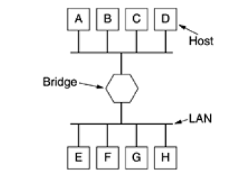
Bridge

Slide 4
Bridges
Bridges are intelligent devices
It has filtering capability
Bridge is a repeater, with add on the functionality of filtering content by reading the MAC addresses of the source and destination.
It is also used for interconnecting two LANs working on the same protocol.
It has a single input and single output port, thus making it a 2 port device.

Slide 5
Uses of Bridge in Computer Network
Bridges can also expand the physical size of a network.
Bridges are also used to connect a LAN segment to another LAN segment in another location via a synchronous modem connection.
Bridges are used to split large, busy networks into smaller, interconnected networks to improve performance.

Slide 6
Types of Bridge
Routing Bridges(Source routing bridges)
Transparent Bridges
Local Bridges
Remote Bridges

Slide 7
Types of Bridge
Routing Bridges(Source routing bridges)
Source routing bridge decides the route between two hosts.
Source routing bridge uses the MAC destination address of a frame to direct it by the source routing algorithm
Transparent Bridges
Transparent Bridges is invisible to the other devices on the network. Transparent Bridge only perform the function of blocking or forwarding data based on MAC address
other devices in the network are entirely unaware that bridges exist

Slide 8
Types of Bridge
Local Bridge
Provides direct connection between multiple LAN segments in same area
Remote Bridge
Connect multiple LAN segments different areas

Slide 9
Switch
Used to join multiple computers together with in one local area network (LAN).
switches operate at layer 2 (Data link layer) in the OSI model.
A switch has many ports, to which computers are plugged in.
Switch are more intelligent than hub
When a data frame arrives at any port of a network switch, it examines the destination address, performs necessary checks and sends the frame to the corresponding device
Switches are used to forward the packets based on MAC addresses.

Slide 10
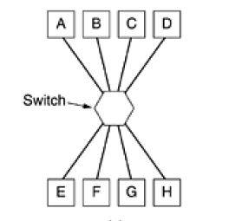
Switch

Slide 11
Switch
Devices connected to switch will be on same subnet
Switch wont send data to computers on different subnet
It is operated in full duplex mode.
Packet collision is minimum as it directly communicates between source and destination.

Slide 12
Router
Routers are networking devices operating at layer 3 or a network layer of the OSI model.
It connects different networks together and sends data packets from one network to another.
It transfers data in the form of IP packets.
In order to transmit data, it uses IP address mentioned in the destination field of the IP packet.
Routers have a routing table in it that is refreshed periodically according to the changes in the network.
In order to transmit data packets, it consults the table and uses a routing protocol.

Slide 13
Router
They are responsible for receiving, analysing, and forwarding data packets among the connected computer networks.
When a data packet arrives, the router inspects the destination address, consults its routing tables to decide the optimal route and then transfers the packet along this route.
Main functions of router are forwarding and routing of packets

Slide 14
Functions of router
Forwarding – The router receives the packets from its input ports, checks its header, performs some basic functions like checking checksum, and then looks up to the routing table to find the appropriate output port to dump the packets onto, and forwards the packets onto that output port.
Routing – Routing is the process by which the router ascertains what is the best path for the packet to reach the destination, It maintains a routing table which is made using different algorithms by the router only.

Slide 15
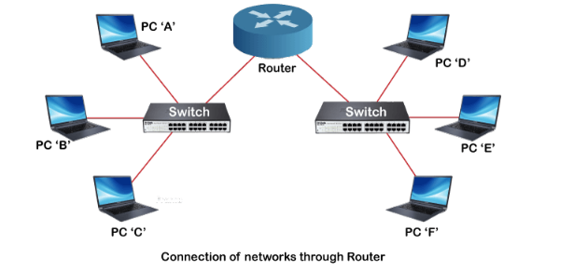
Connection of networks through router

Slide 16
Types of Router
There are mainly two types of the router
1. Wireless Router
2. Wired Router/Broadband Router

Slide 17
Types of Router
There are mainly two types of the router, which are given below:
1. Wireless Router
Wireless routers are the most commonly used routers in offices and homes as they don't need any wire or cable to connect with networking devices.
It provides a secure connection, and only authenticated users can access the network using the id & password.
Using wireless router, internet can be accessed by the n number of users within the specified range.
2. Wired Router/Broadband Router
As its name suggests, it requires a wire or cable to connect to the network devices.
Such routers are mostly used in schools or small offices to connect the PCs with the Ethernet cable.
It also has a Wi-fi access point, and a mobile phone can be connected to it using the VOIP (Voice-over-Internet Protocol) technology.

Slide 18
Gateways
Connects two networks with different communication protocols, data format or different architectures.
The gateway acts as a “Translator” or protocol converter in between two different systems
Depending on its functionality it operates in all the layers of the model
For eg transport gateways connect two computers that use different connection-oriented transport protocols.
suppose a computer using the connection-oriented TCP/IP protocol needs to talk to a computer using the connection-oriented ATM transport protocol.
The transport gateway can copy the packets from one connection to the other, reformatting them as need be.

Slide 19
Gateways
Application gateways understand the format and contents of the data and translate messages from one format to another.
An e-mail gateway could translate Internet messages into SMS messages for mobile phones.
In other words, a gateway is a node on a network that serves as an entrance to another network.
They take data from one system, interpret it, and transfer it to another system.

Slide 20
Gateways
A Gateway is the most intelligent device among the network connecting devices.
Intelligent in terms of its working, error control, data packet routing, transmission speed, etc.
It is a combination of both hardware as well as software components.

Slide 21
Brouter
– It is also known as the bridging router is a device that combines features of both bridge and router.
It can work either at the data link layer or a network layer.
Working as a router, it is capable of routing packets across networks and working as the bridge, it is capable of filtering local area network traffic.

Slide 22
NIC- Network interface card
NIC or network interface card is a network adapter that is used to connect the computer to the network.
It is installed in the computer to establish a LAN.
It has a unique id(MAC address) that is written on the chip, and it has a connector to connect the cable to it.
The cable acts as an interface between the computer and the router or modem.
NIC card is a layer 2 device which means that it works on both the physical and data link layers of the network model.

